Slide 1
Enhancing Multi-Object Relationship Representation in Subject-Diffusion Models
Team 5 Midterm presentation
Se Hun Park
Geon Gyu Oh

Slide 2
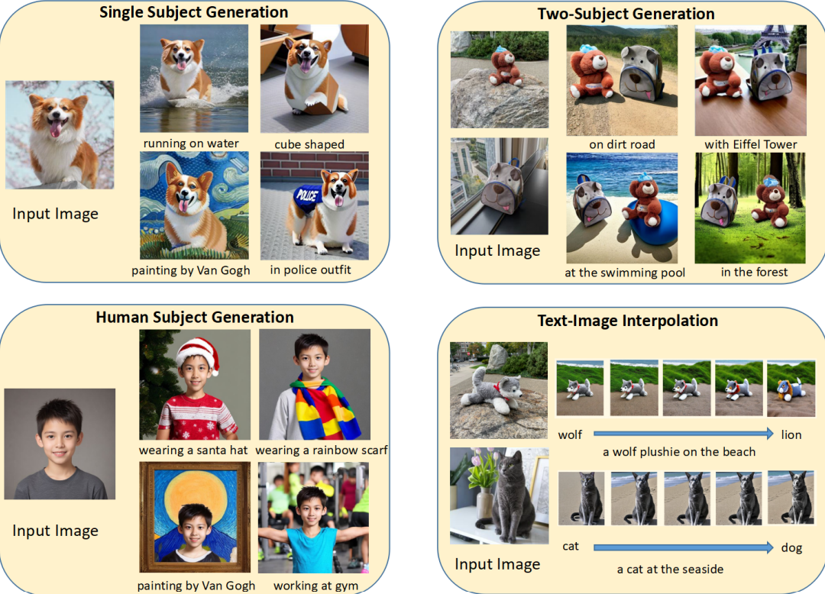
Project which the paper had done
Preview of the Paper Presentation 02.
Subject-Diffusion
Notes:
Before our main presentation, we will introduce shortly about our paper presentation 2.
The title of paper is Subject-Diffusion: Open Domain Personalized Text-to-Image Generation without Test-time Fine-tuning.

Slide 3
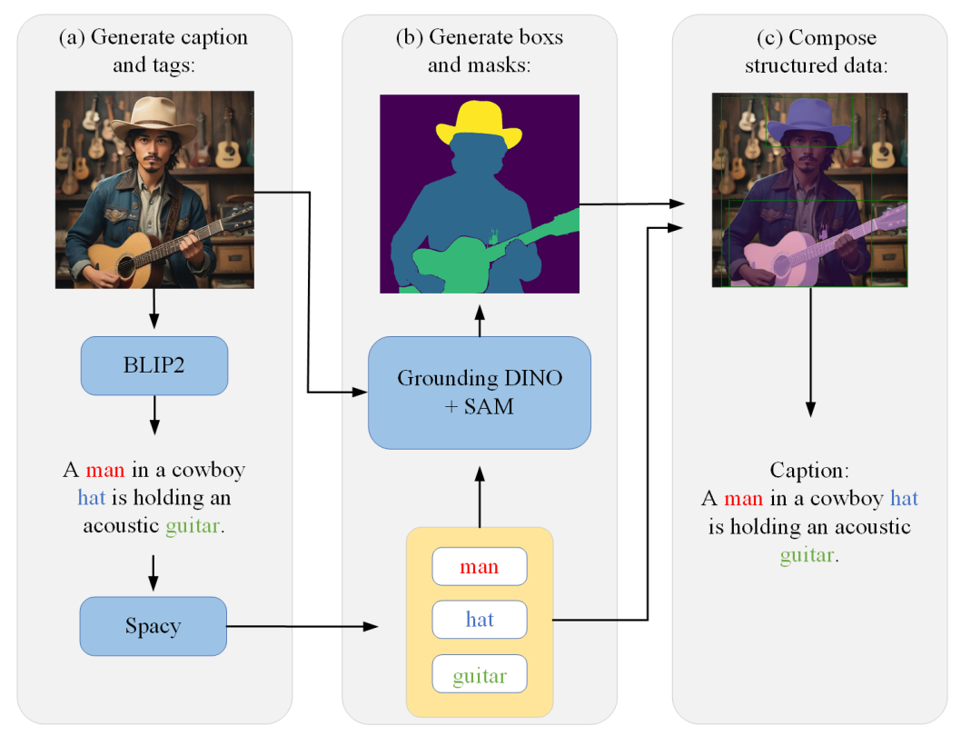
Project which the paper had done
Preview of the Paper Presentation 02.
Subject-Diffusion
Dataset Construction
Notes:
It uses the combination of

Slide 4
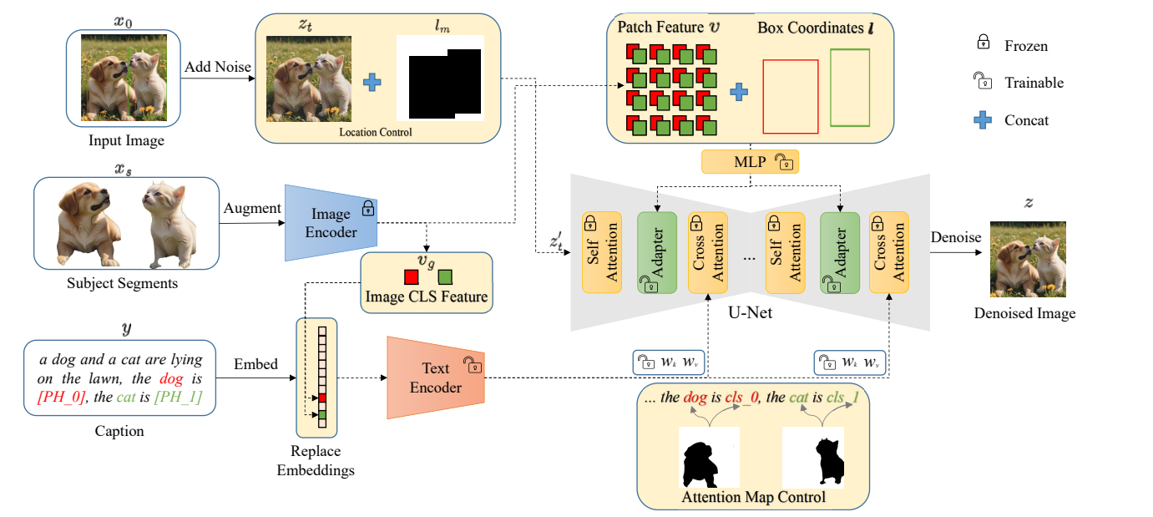
Project which the paper had done
Preview of the Paper Presentation 02.
Subject-Diffusion
Design of the Model

Slide 5
Limitation of the project inside the paper
Limitations of the Subject-Diffusion :
Difficulty in accurately representing object relationships (e.g., position, size, and distance).
Limited flexibility in generating scenes with multiple interacting objects.
Notes:
First, our method faces challenges in editing attributes and accessories within user-input images, leading to limitations in the scope of the model’s applicability. Secondly, when generating personalized images for more than two subjects, our model will fail to render harmonious images with a high probability.

Slide 6
Our projects’ objective
Primary Goal:
To develop a model that can generate images with natural and accurate multi-object relationships based on textual descriptions.
Key Focus:
Improving spatial understanding and relationship depiction.
Notes:
Our primary goal of the our project is to overcome the limitation of model inside the paper.
First, we try to develop a original model to a new model which able to generate image with natural and accurate multi-object relationships based on textual descriptions.
Additionally, We are trying to focus on improving spatial understanding and relationship depiction, to make the model that produce richer outputs with better text-to-image alignment and enable the creation of more detailed and contextually accurate scenes.

Slide 7
Our projects outline
Step 1: Dataset preparation
Step 2: Improve the given model
Step 3: Final evaluation with varied relational prompts and performance analysis.
Notes:
This is our project outline. We divided this to three steps.

Slide 8
Step 1 : Dataset Preparation
Tasks:
Collect and label relational text-image pairs.
Preprocess data to extract and tag relational cues.
Expected Output:
A structured data set ready for training.
Notes:
The first step is dataset preparation.

Slide 9
Step 2 : Model Enhancement
Tasks: Train a model by using datasets in Step 1
Try to Adjust U-Net to focus on object interactions.
Notes:
The second step is model enhancement. The main task is training a model by using datasets which are made from step 1.
In the model enhancement, we are planning to try adjusting U-net, in order to focus object interactions.
The original U-net is

Slide 10
Step 2 : Model Enhancement
Tasks: Train a model by using datasets in Step 1
Integrate enhanced text encoding for relationship cues
Expected Output: A prototype model with improved relationship handling

Slide 11
Step 3 : Comprehensive Testing
Tasks:
Use diverse test prompts (e.g., "A huge eraser placed right of a small pen").
Evaluate generated images for accuracy in relational depiction.
Expected Output: Performance report with visual examples.
Evaluation Metrics
Text-Image Alignment
Measure how accurately images match the relational details in the text.
Object Interaction Quality:
Assess naturalness of object placement and interaction.
Notes:
The final step is comprehensive testing. In order to test, we will use diverse test prompts-the combination of texts

Slide 12
Expected Outcomes
Enhanced Model Capabilities:
Improved multi-object interaction representation.
Higher accuracy in complex scene generation.

Slide 13
Summary
What is Subject-Diffusion?
A diffusion-based model that generates personalized images from text prompts.
Works effectively for single or dual objects but lacks control over complex object interactions.
Purpose of the Project:
Enhance the model to handle complex relationships between multiple objects.
Steps we used
Dataset preparation
Improve the model
Final evaluation with varied relational prompts and performance analysis.

Slide 14
Q&A

